Slide 1

Universal Medical Form Reader
User Guide: how to create your first HTML form with the Universal PDF Reader
This document was written in August 2021

Slide 2
Universal Form Reader
Contents
Pre-requisites for the running......................................................................................... 3
Downloading and storing files on system .......................................................... 4
Understanding execution order...................................................... 8
Make sure the HTML is integrated with the system.............................................................................................. 16

Slide 3
Universal Form Reader
Pre-requisites for the running
Mandatory
Python (Latest Version)
Anaconda
Libraries/dependencies
Spyder
Notepad
Optional
Adobe Acrobat

Slide 4
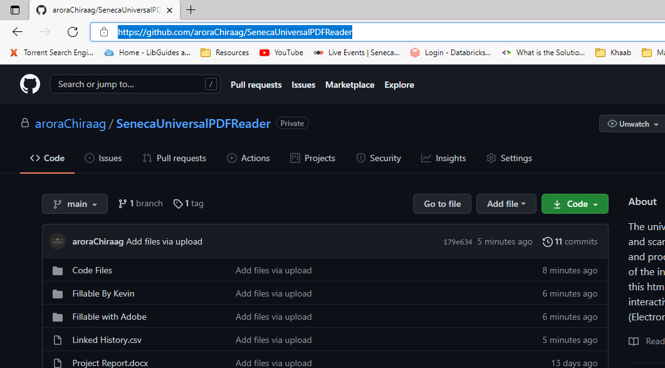
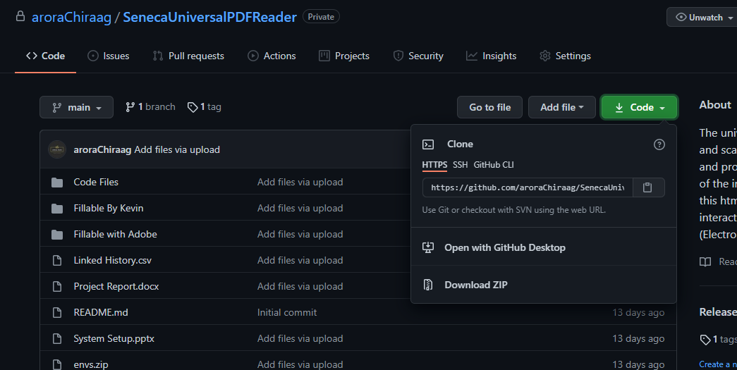
Universal Form Reader
Downloading and storing files on system
Step1. Download Files from the repository. Go to the GitHub Website, select Code, and then choose Download Zip.
Notes:
aroraChiraag/SenecaUniversalPDFReader: The universal PDF reader system reads and scan the fillable pdf files as input and process them to give the html file of the interactive elements in pdf files, this html file can be used to upload the interactive elements of pdf file in EMR (Electronic medical record) system. (github.com)

Slide 5
Universal Form Reader
Downloading and storing files on system
Step1. You can also go to Tags and check the new releases. Select the drop down of the Assets, and then choose Source Code.
Notes:
aroraChiraag/SenecaUniversalPDFReader: The universal PDF reader system reads and scan the fillable pdf files as input and process them to give the html file of the interactive elements in pdf files, this html file can be used to upload the interactive elements of pdf file in EMR (Electronic medical record) system. (github.com)

Slide 6
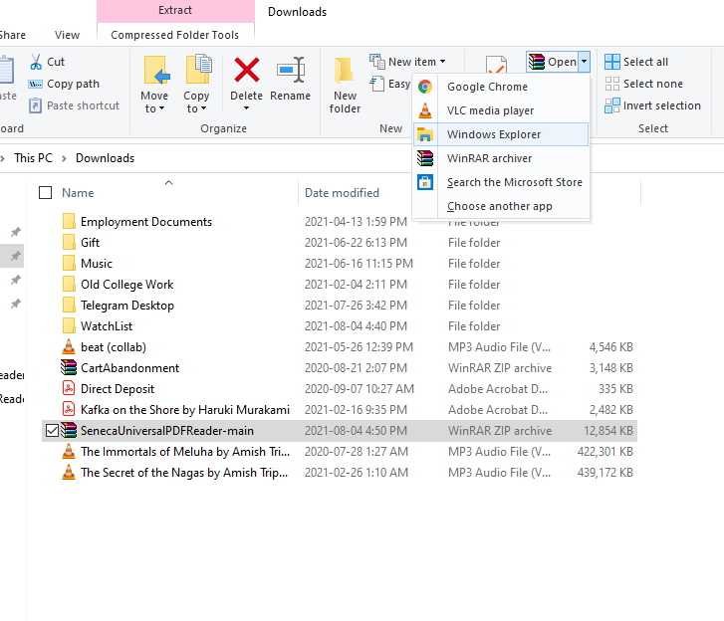
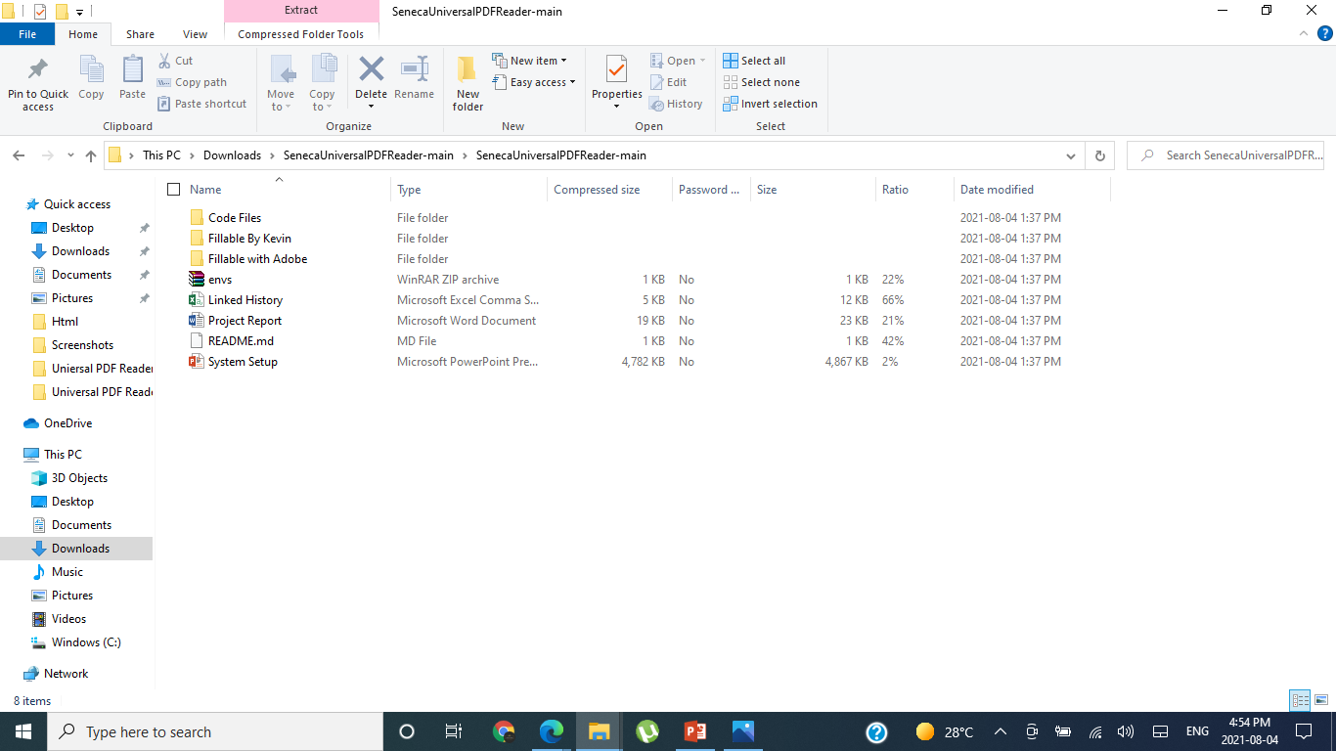
Universal Form Reader
Downloading and storing files on system
Step2. Open the downloaded zip file with unzip tool or windows explorer.
Notes:
aroraChiraag/SenecaUniversalPDFReader: The universal PDF reader system reads and scan the fillable pdf files as input and process them to give the html file of the interactive elements in pdf files, this html file can be used to upload the interactive elements of pdf file in EMR (Electronic medical record) system. (github.com)

Slide 7
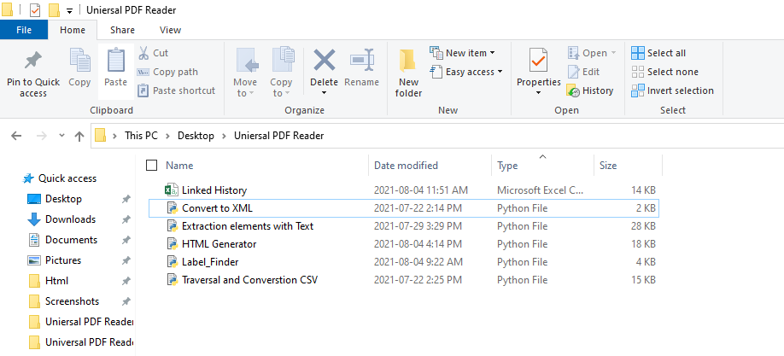
Universal Form Reader
Downloading and storing files on system
Step3. Copy all the “Code” files, “PDF” files and “Linked History” in a desired location.
Notes:
aroraChiraag/SenecaUniversalPDFReader: The universal PDF reader system reads and scan the fillable pdf files as input and process them to give the html file of the interactive elements in pdf files, this html file can be used to upload the interactive elements of pdf file in EMR (Electronic medical record) system. (github.com)

Slide 8
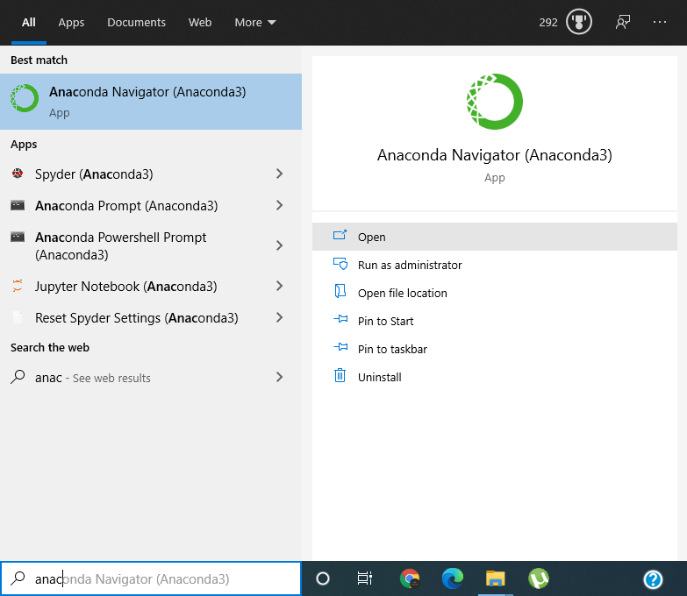
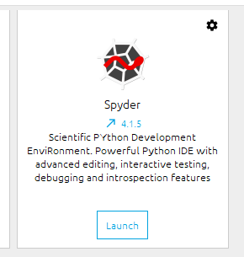
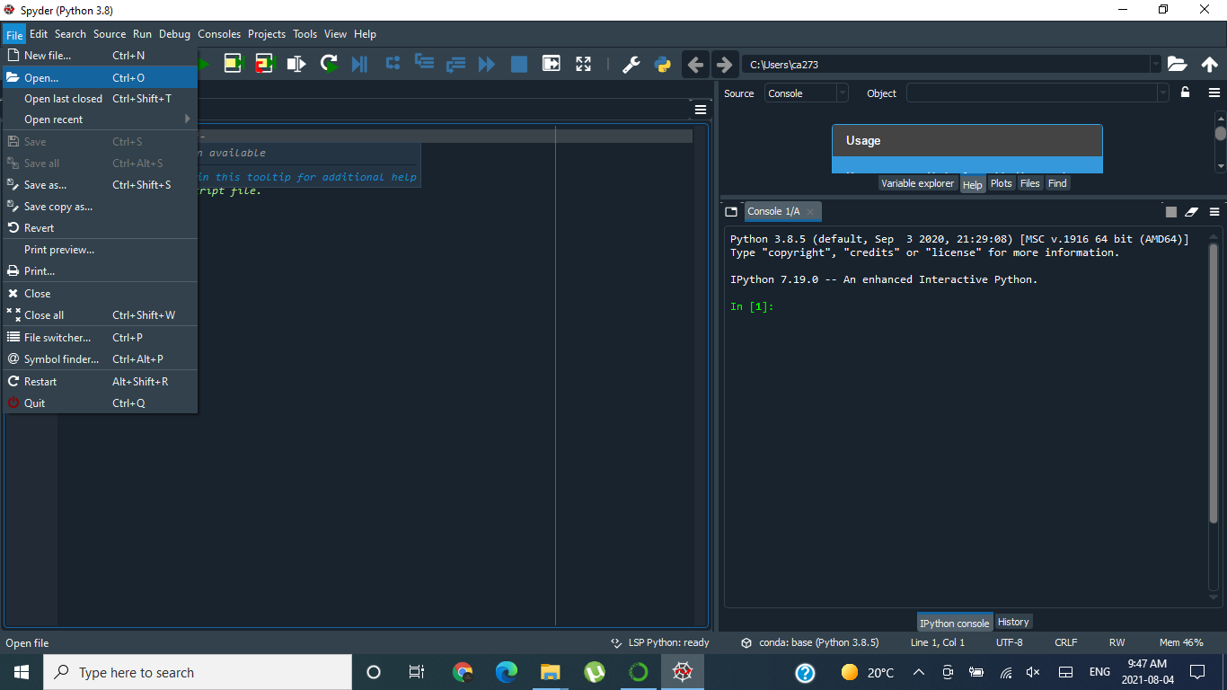
Universal Form Reader
Understanding execution order
Step4. Open the Anaconda Navigator, make sure the application on is set to DSB and execute the Spyder IDE.
Note: Remember to put all the PDFs, Linked History and Code file in the same folder.

Slide 9
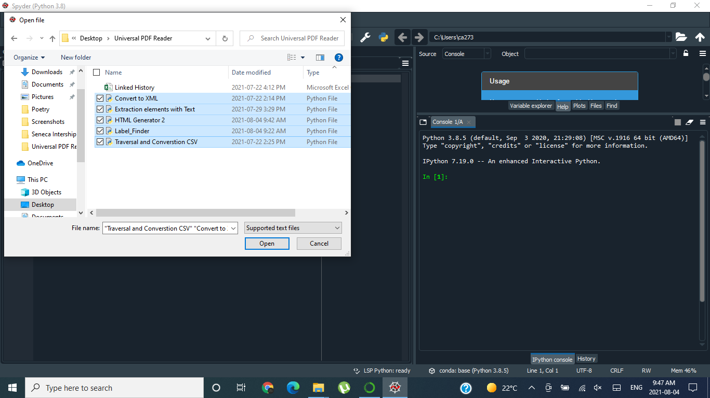
Universal Form Reader
Understanding execution order
Step5. Open the code files in Spyder IDE.

Slide 10
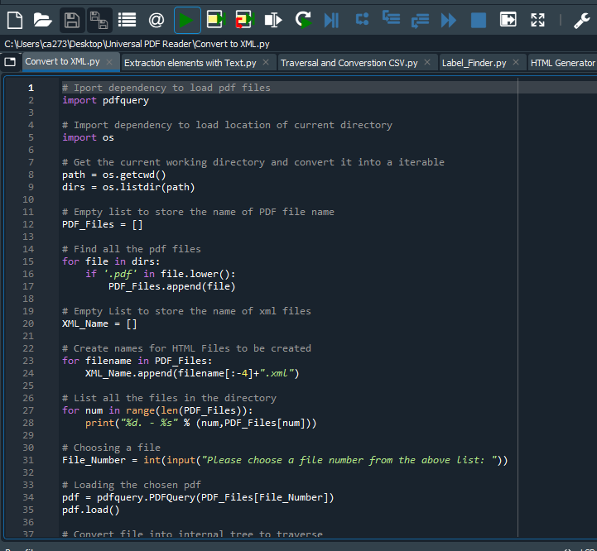
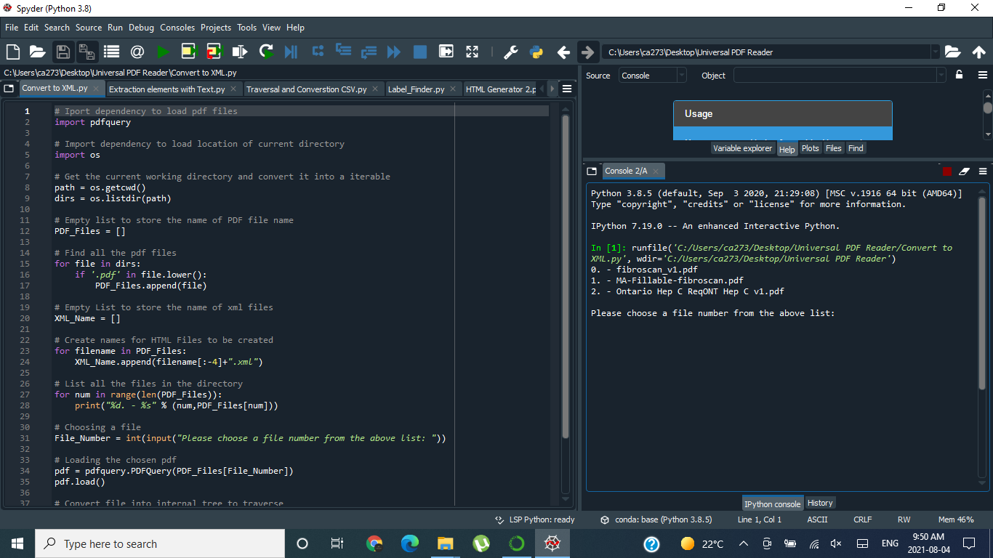
Universal Form Reader
Understanding execution order
Step6. Begin with the Convert to XML, press the green button to run and then choose the form in the console.

Slide 11
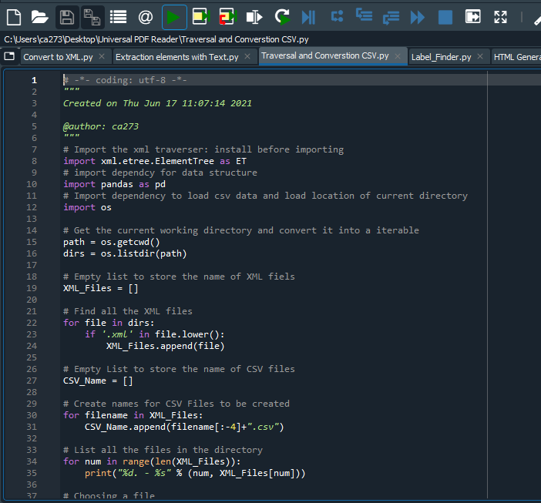
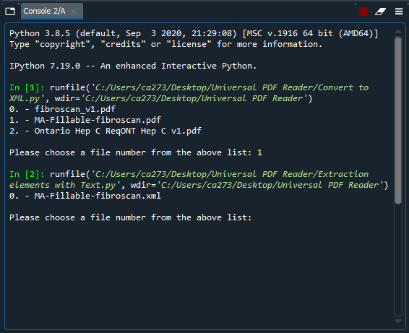
Universal Form Reader
Understanding execution order
Step7. Next up is Traversal and Conversion CSV, press the green button to run and then choose the form in the console.

Slide 12
Universal Form Reader
Understanding execution order
Step7. Next up is Extraction elements with Text, press the green button to run and then choose the form in the console.

Slide 13
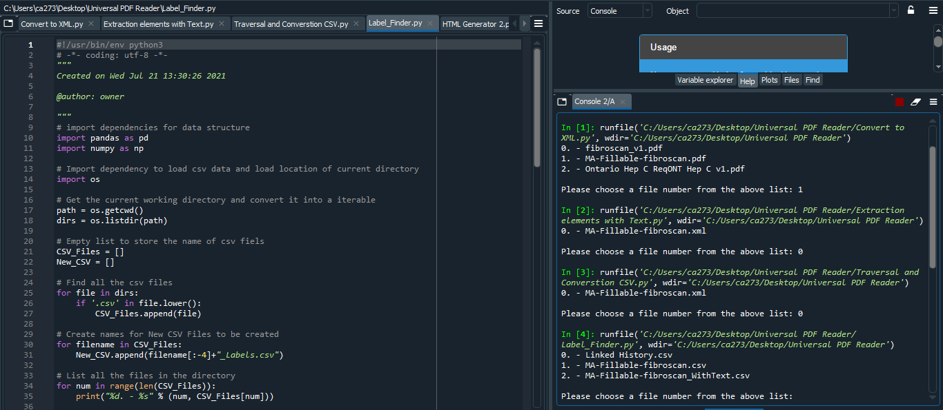
Universal Form Reader
Understanding execution order
Step8. Next up is Label Finder, press the green button to run and then choose the form in the console.
Remember to select the csv of the form with the _WithText.csv at the end.

Slide 14
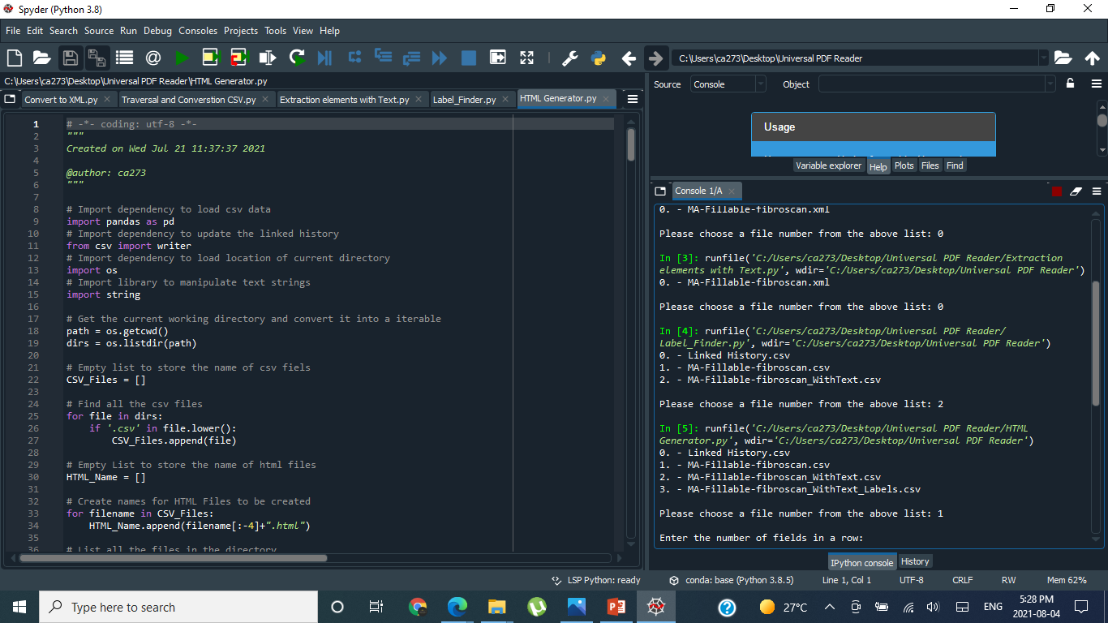
Universal Form Reader
Understanding execution order
Step9. Last up is the HTML Generator, press the green button to run and then choose the form in the console.
Remember to select the csv of the form with the “Form_Name.csv” at the end.

Slide 15
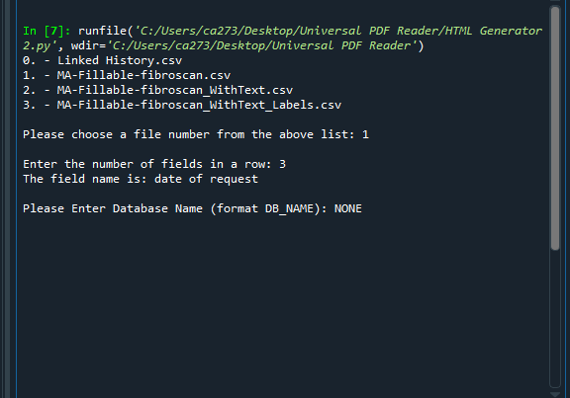
Universal Form Reader
Understanding execution order
Step10. Select how many elements do you want each line, if there is any element that is not there in linked History or Text Labels, it will ask you to add it to the csv Linked History file with name of the label listed already for you.

Slide 16
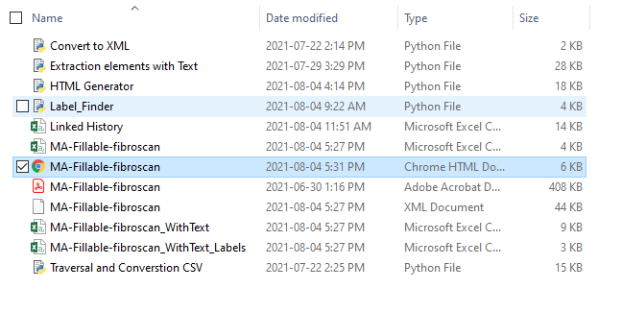
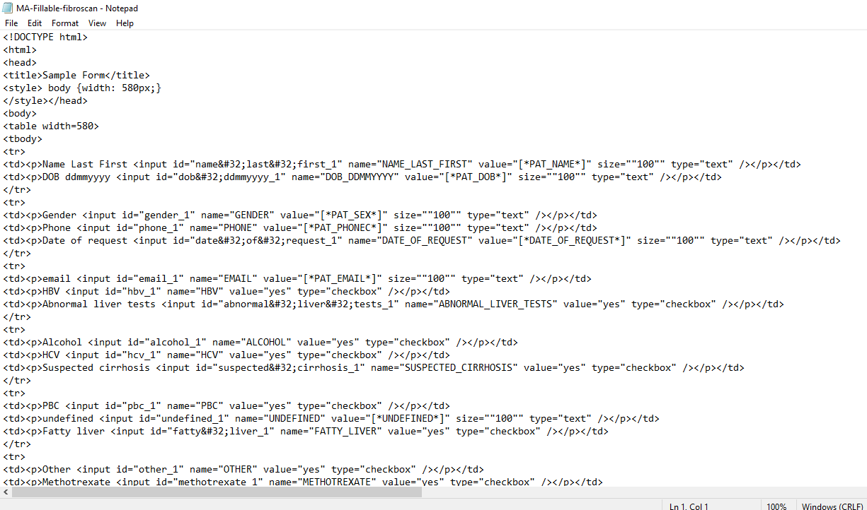
Universal Form Reader
Make sure the HTML is integrated with the system
Step11. Here we have the HTML which should be executed with a notepad to copy the content onto the system.

